Slide 1
Data Mining & Warehousing
By
Prof. Dr. O.P.Vyas
DAAD Fellow (Germany), AOTS Fellow(Japan)
Indian Institute of Information Technology, Allahabad

Slide 2
D.M.W.
Data Mining
  Overview of Data Engineering
  DM: Overview of Techniques
    Algorithms & Implementations
  Association Rule Mining: Apriori Algorithm
  Issues in DM : User-Centric Vs Procedure centric
    Utility Mining issues
    Rare item Problem:Single MinSup problem
  Classification & Predictive mechanism: Overview of DTC
  Issues wrt Data Mining: Problem of Overfitting & Outliers
  Associative Classification
  Clustering Analysis
  Business Planning & Forecasting Technologies
  Computational Knowledge Discovery
  Association Rules Vs. Business Rules.
  Companies using Business Intelligence
    Master Card, Wall Mart, Burger King,
Social Network Analysis & Data Mining

Slide 3
Data Mining Functionalities
Data Mining
Association
Mining
Clustering
Analysis
Classification
A:R:M:
Techniques
Application
domain
Classification
Techniques
Asso.Classifiers

Slide 4
Data Mining
Data Mining
Association
Mining
Clustering
Classification
Techniques
Classification
Techniques
Associative Classification
(Combines the Association & Classification)
CBA, CMAR, CPAR & MCLP
Modifying the algorithms
Application
domain

Slide 5
DMW
DM Functionalities: Descriptive Vs Predictive
ARM-Apriori VS FP Algorithm
  Learning: Supervised & Unsupervised
  Association & Classification: Overview
    Working mechanism of Decision Tree Classifier
    Overfitting in General and in DTC
    Associative Classification
  Clustering Analysis
    Searching Authoritative pages
    PageRank Algorithm

Slide 6
Overview of Apriori & FP Growth
Both work on Support-Confidence framework
Both are Frequent Pattern Mining approach

Slide 7
Problems with Association Rules Algorithms
Users are overwhelmed by the number of rules identified ─ how can the number of rules be reduced to those that are relevant to the user needs?
Apriori algorithm assumes sparsity since number of items on each record is quite small.
Some applications produce dense data which may also have
  many frequently occurring items
  strong correlations
  many items on each record
December 2008
©GKGupta

Slide 8
Problems with Association Rules
Also consider:
AB → C (90% confidence)
and A → C (92% confidence)
Clearly the first rule is of no use.
We should look for more complex rules only if they are better than simple rules.
December 2008
©GKGupta

Slide 9
Apriori Vs FP
Apriori: uses a generate-and-test approach – generates candidate itemsets and tests if they are frequent
  Generation of candidate itemsets is expensive(in both space and time)
  Support counting is expensive
    Subset checking (computationally expensive)
    Multiple Database scans (I/O)
FP-Growth: allows frequent itemset discovery without candidate itemset generation.
      Two step approach:
  Step 1: Build a compact data structure called the FP-tree
    Built using 2 passes over the data-set.
  Step 2: Extracts frequent itemsets directly from the FP-tree

Slide 10








The Apriori Algorithm — Candidate itemsets..
Database D
L₁
C₁
Scan D
C₂
C₂
L₂
Scan D
C₃
Scan D
L₃
Notes:
Ranjana vyas

Slide 11
FP Tree: Discussion
Advantages of FP-Growth
  only 2 passes over data-set
  “compresses” data-set
  no candidate generation
  much faster than Apriori
Disadvantages of FP-Growth
  FP-Tree may not fit in memory!!
  FP-Tree is expensive to build

Slide 12
Though slightly different in their approach in finding frequent itemsets, both Apriori & FP uses same theoretical basis
Support & Confidence framework
Support & Confidence both work on the basis of Probability theory

Slide 13
ARM: Apriori & FP
Apriori though is the pioneer in generating frequent itemsets and thus Association rules, but suffers in performance.
Needs minsup and minconf to be specified in advance.
The Candidate set generation C in Apriori is expensive and causes major bottleneck when the itemsets are large.
  Number of Database scans will be high.
  High search space is required.
Some variants like AprioriTid avoids Number of Database scans but Candidate set generation problem remains.
FP generates frequent itemsets without candidate set generation thus more efficient.
Needs minsup and minconf to be specified in advance.
Conditional Frequent Pattern tree is generated rather than Candidate set generation
The number of Database scans are very less (generally only two scans are sufficient)
Recursive mining of conditional FP Tree is done and complete but compact tree is generated.
Apriori & FP Tree both generate same set of results but FP proves to be more efficient in general.

Slide 14
Improving the Apriori Algorithm
Many techniques for improving the efficiency have been proposed during past years:
  Pruning
  Hashing based technique
  Transaction reduction
  Partitioning
  Sampling
  Dynamic itemset counting
December 2008
©GKGupta

Slide 15
Classification and Prediction
What is Classification?
Issues regarding classification and prediction
Classification by decision tree induction
Bayesian Classification
Rule-based classification
Classification by back propagation (ANN)
Support Vector Machines (SVM)
Associative Classification
Lazy learners (or learning from your neighbors)
Other Classification methods
  Rough Set Approach
  Fuzzy Set approach
  Genetic Algorithm
Ensemble methods
Prediction
Accuracy and error measures
Model selection
Summary
Data Mining: Concepts and Techniques

Slide 16

Decision Tree Classification Task
Decision Tree

Slide 17
DTC
Decision tree is a classifier in the form of a tree structure
  Decision node: specifies a test on a single attribute
  Leaf node: indicates the value of the target attribute
  Arc/edge: split of one attribute
  Path: a disjunction of test to make the final decision
Decision trees classify instances or examples by starting at the root of the tree and moving through it until a leaf node.

Slide 18
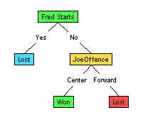
DTC: Illustration
(1) Which to start? (root)
(2) Which node to proceed?
(3) When to stop/ come to conclusion?

Slide 19
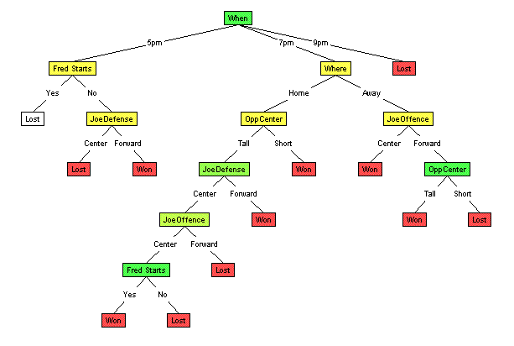
Random split
The tree can grow huge
These trees are hard to understand.
Larger trees are typically less accurate than smaller trees.

Slide 20
Principled Criterion
Selection of an attribute to test at each node - choosing the most useful attribute for classifying examples.
information gain
  measures how well a given attribute separates the training examples according to their target classification
  This measure is used to select among the candidate attributes at each step while growing the tree

Slide 21
Data Mining & Overfitting
The cause of poor performance in machine learning is either overfitting or underfitting the data.
Overfitting happens when a model learns the detail and noise in the training data to the extent that it negatively impacts the performance of the model on new data.
This means that the noise or random fluctuations in the training data is picked up and learned as concepts by the model.
The problem is that these concepts do not apply to new data and negatively impact the models ability to generalize.

Slide 22
Problems of Overfitting in Tree
Overfitting can lead to many difficulties
when training data set is noisy
when training data set is too small
Decision Trees are a nonparametric machine learning algorithm that is very flexible and is subject to overfitting training data.
This problem can be addressed by pruning a tree after it has learned in order to remove some of the detail it has picked up
If there is no conflicting instances in the training data set then error of the fully build tree is zero while the true error is likely to be bigger.
Overfitted models are incorrect.
Require more space and more computational resources
Require collection of unnecessary features
They are more difficult to comprehend

Slide 23
Overfitting the Data
When a decision tree is built, many of the branches may reflect anomalies in the training data due to noise or outliers.
We may grow the tree just deeply enough to perfectly classify the training data set.
This problem is known as overfitting the data.
Overfitting is a significant practical difficulty for decision tree models and many other predictive models.
Overfitting happens when the learning algorithm continues to develop hypotheses that reduce training set error at the cost of an increased test set error.

Slide 24
Definition
A decision tree T is said to overfit the training data if there exists some other tree T’ which is a simplification of T, such that T has smaller error than T’ over the training set but T’ has a smaller error than T over the entire distribution of the instances.

Slide 25
Pre-pruning that stop growing the tree earlier, before it perfectly classifies the training set.
Post-pruning that allows the tree to perfectly classify the training set, and then post prune the tree.

Slide 26
Overfitting & Tree Pruning
  Two approaches
  pre-pruning approach
  post-pruning approach
  Prepruning approach- tree is pruned by halting the tree construction i.e. by deciding not to further split or partition the subset of training samples at a given node.
  Upon halting, a node becomes a leaf node. The leaf may hold the most frequent class among the subset samples.
  If partitioning of samples at a node would result in a split that falls below a pre-specified threshold of measure (such as information gain etc), then further partitioning can be halted.

Slide 27
Tree Pruning
The important step of tree pruning is to define a criterion be used to determine the correct final tree size using one of the following methods:
        Use a distinct dataset from the training set (called validation set), to evaluate the effect of post-pruning nodes from the tree.
        Build the tree by using the training set, then apply a statistical test to estimate whether pruning or expanding a particular node is likely to produce an improvement beyond the training set.
  Error estimation
  Significance testing (e.g., Chi-square test)
Minimum Description Length principle : Use an explicit measure of the complexity for encoding the training set and the decision tree, stopping growth of the tree when this encoding size (size(tree) + size(misclassifications(tree)) is minimized.

Slide 28
Post-pruning
  Post-pruning approach- removes branches of a fully grown tree.
Subtree replacement replaces a subtree with a single leaf node
Alt
Alt
Yes
Yes
Price
Yes
$
$$$
$$
Yes
Yes
No

Slide 29
Post-pruning
Subtree raising moves a subtree to a higher level in the decision tree, subsuming its parent
Alt
Alt
Yes
Yes
Res
Price
No
Yes
$
$$$
Price
No
$$
4/4
Yes
Yes
No
$
$$$
$$
Yes
Yes
No

Slide 30
Post-pruning: Techniques
Cost Complexity pruning Algorithm: pruning operation is performed if it does not increase the estimated error rate.
  Of course, error on the training data is not the useful estimator (would result in almost no pruning)
Minimum Description Length Algorithm: states that the best tree is the one that can be encoded using the fewest number of bits.
  The challenge for the pruning phase is to find the subtree that can be encoded with the least number of bits.

Slide 31
Overview of Classifiers

Slide 32
Data Mining Functionalities
Data Mining
Association
Mining
Clustering
Classification
Techniques
Application Domain
Market Basket Analysis
Various products bought by a customer in a Supermarket were analysed for “interdependency”.
Mining Result is used for, Shelf space organization,formulating discounting-policies and for selective marketing.
What kinds of DNA are sensitive to this new drug?
Classification
Techniques
Assoc.
Classification

Slide 33
Data Mining
Data Mining
Clustering
Association
Mining
Classification
Clustering is the process of grouping a set of (physical or abstract) objects into classes of similar objects
Spatial Data Mining & Web Mining
K-Means Algo (Mac-Queen et al., 1967)
CLARANS (Han et al., 1994)
DBSCAN ( Ester et al 1996)
Search Engine Result Mining
Categorizes documents using phrases in titles and snippets.
Clustering Search Result (Leouski and Croft, 1996, Zamir and Etzioni, 1997).
PageRank Algorithm – Google Search Engine
Application
Domain
Classification
Techniques
Techniques
Asso.Classification

Slide 34
Data Mining
Data Mining
Association
Mining
Clustering
Classification
Techniques
Classification mining analyzes a set of training data (i.e. a set of objects whose class labels are known) and constructs a model for each class based on the features in the data.
A set of classification rules are generated by the classification process, and these can be used to classify future data, as well as develop a better understanding of each class in the database.
Associative
Classification
Application
domain

Slide 35
Data Mining
Data Mining
Association
Mining
Clustering
Classification
Techniques
Classification
Techniques
Associative Classification
(Combines the Association & Classification)
CBA, CMAR, CPAR & MCLP
Modifying the algorithms
Application
domain

Slide 36
Associative classification (AC) is a promising data mining approach that integrates classification and association rule discovery to build classification models (classifiers).

Slide 37
Associative Classification
Can any ideas from association rule mining be applied to classification?
Both Association pattern discovery and Classification rule mining are essential to practical data mining applications. If these two relevant jobs can be somehow integrated, great savings and conveniences to the user could result.
A new classification approach known as Associative
Classification integrates association mining and classification into a single system .
Association mining, or pattern discovery, aims to discover descriptive knowledge from databases, while classification focuses on building a classification model for categorizing new data.

Slide 38
Associative Classification
A typical Associative Classification system is constructed in two stages:
Discovering all the event associations (in which the frequency of occurrences is significant according to some tests).
Generating classification rules from the association patterns to build a classifier.
In the first stage, the learning target is to discover the association patterns inherent in a database (also referred to as knowledge discovery).
In the second stage, the task is to select a small set of relevant association patterns discovered to construct a classifier given the predicting attribute.

Slide 39
Associative Classification
Experiments reported in showed that associative classification systems achieve competitive classification results with traditional classification approaches such as DTC-C4.5.
The reasons are that the associative classifier is composed of high quality rules, which are generated from highly confident event associations that reflect the close dependencies among events; and, when classifying a new object, only significant rules are used.
The integration is done by focusing on a special subset
of association rules whose right-hand-side are restricted to
the classification class attribute. We refer to this subset of rules as the Class Association Rules (CARs).

Slide 40
Associative Classification
An existing association rule mining algorithm (Agrawal and Srikant 1994) is adapted to mine all the CARs that satisfy the minimum support and minimum confidence constraints.
This adaptation is necessary for two main reasons:
Unlike a transactional database normally used in association rule mining (Agrawal and Srikant 1994) that does not have many associations, classification data tends to contain a huge number of associations. Adaptation of the existing association rule mining algorithm to mine only the CARs is needed so as to reduce the number of rules generated, thus avoiding combinatorial explosion.
Classification datasets often contain many continuous (or numeric) attributes. Mining of association rules with continuous attributes is still a major research issue Our adaptation involves discretizing continuous attributes based on the classification predetermined class target. There are many good discretization algorithms for this purpose (Fayyad and Irani 1993; Dougherty, Kohavi and Sahami 1995).

Slide 41
Associative Classification
Data mining in the proposed associative classification framework thus consists of three steps:
i) discretizing continuous attributes, if any
ii) generating all the class association rules (CARs), and
iii) building a classifier based on the generated CARs.
This work makes the following contributions:
1. It proposes a new way to build accurate classifiers. Experimental results show that classifiers built this way are, in general, more accurate than those produced by the state-of-the-art classification system C4.5 (Quinlan 1992).
2. It makes association rule mining techniques applicable to classification tasks.
3. It helps to solve a number of important problems with the existing classification systems.

Slide 42

Association Rule Based Classifier
CBA , Li 1998
CMAR( It uses Fp-tree Structure) Han ,2001
Increases the efficiency
Calendar Association Rule
based Classifier
Increases the efficiency & reduce space complexity

Slide 43
Association-Based Classification
Several methods for association-based classification
  ARCS( Association rule Clustering System): Quantitative association mining and clustering of association rules (Lent et al’97)
    It beats C4.5 in (mainly) scalability and also accuracy
  Associative classification: (Liu et al’98)
    It mines high support and high confidence rules in the form of “cond_set => y”, where y is a class label
  CAEP (Classification by aggregating emerging patterns) (Dong et al’99)
    Emerging patterns (EPs): the itemsets whose support increases significantly from one class to another
    Mine Eps based on minimum support and growth rate

Slide 44
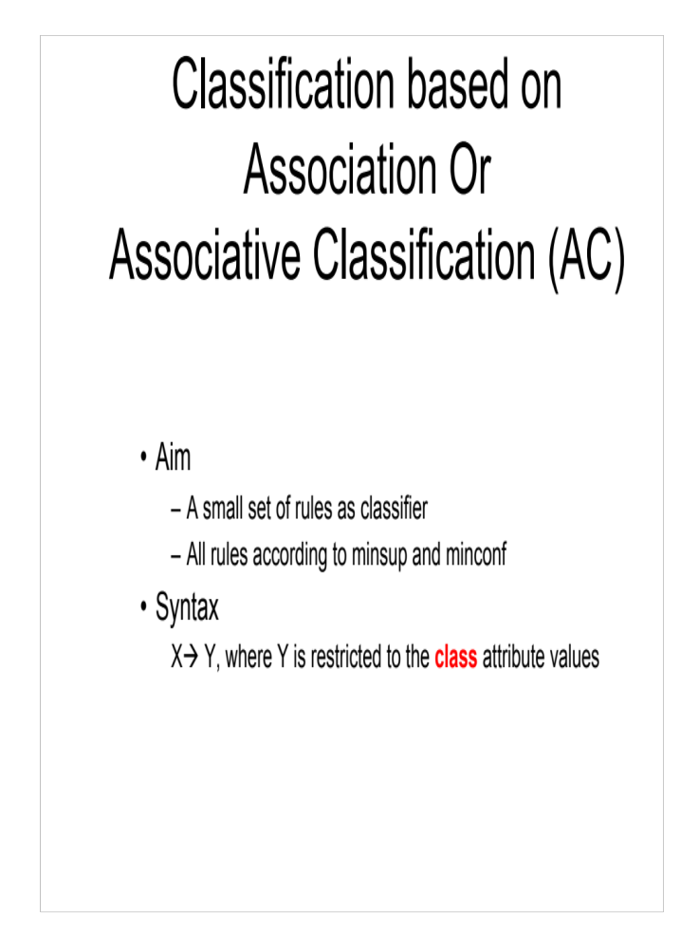

Slide 45
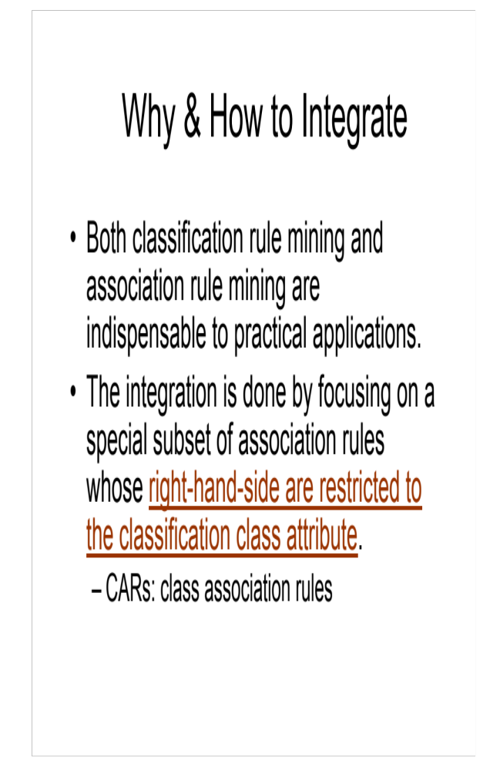

Slide 46
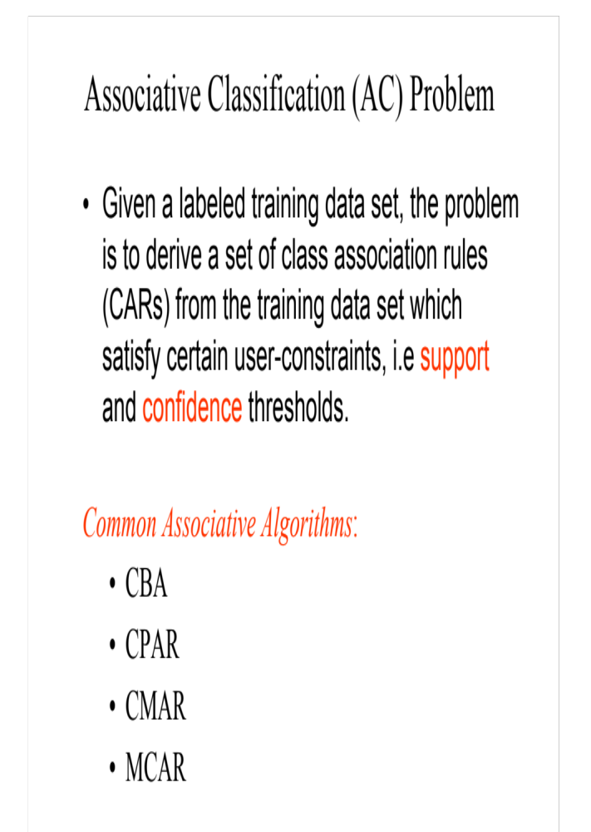

Slide 47
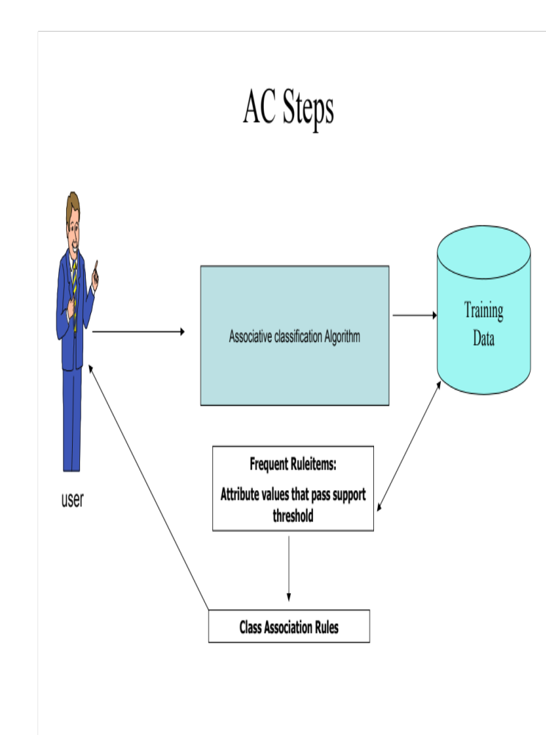

Slide 48
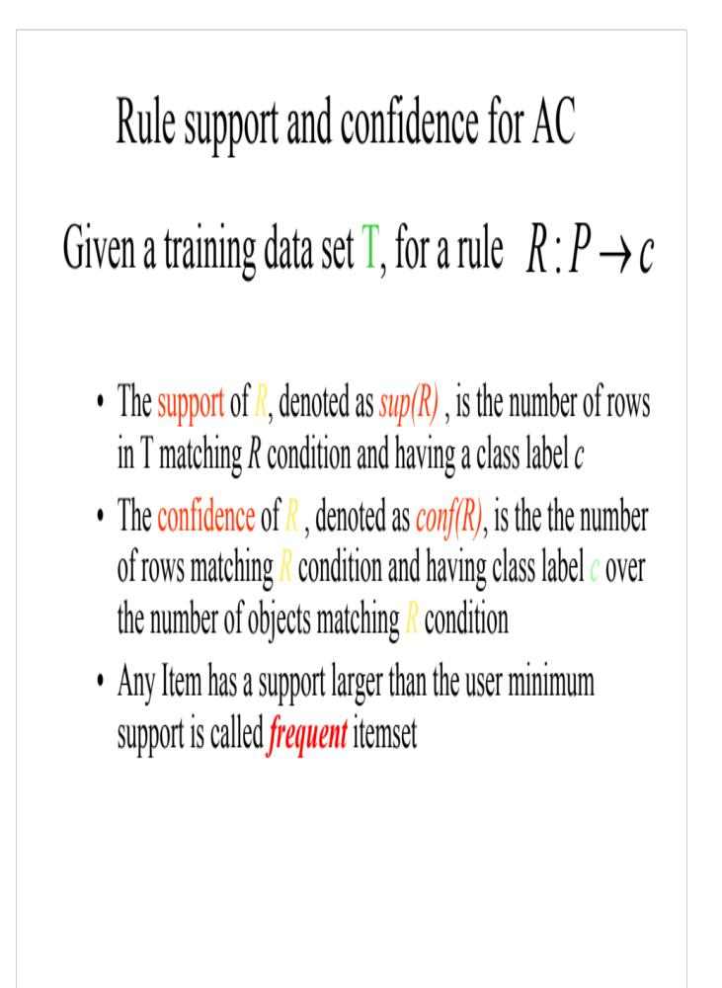

Slide 49
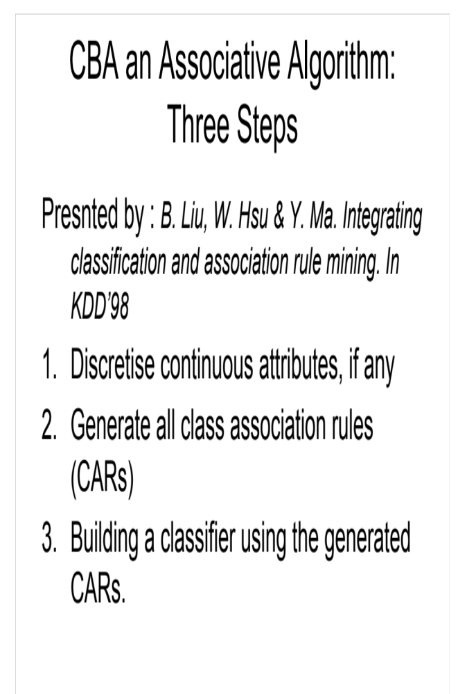

Slide 50
Outliers
Outliers Analysis
Outliers Mining

Slide 51

What Are Outliers?
Outlier: A data object that deviates significantly from the normal objects as if it were generated by a different mechanism
  Ex.: Unusual credit card purchase, sports: Sachin Tendulkar, ...Health Care: B.P. measurements !
Outliers are different from the noise data
  Noise is random error or variance in a measured variable
  Noise should be removed before outlier detection
Outliers are interesting: It violates the mechanism that generates the normal data
Outlier detection vs. novelty detection: early stage, outlier; but later merged into the model
Applications:
  Credit card fraud detection
  Telecom fraud detection
  Customer segmentation
  Medical analysis

Slide 52
Types of Outliers (I)
Three kinds: global, contextual and collective outliers
Global outlier (or point anomaly)
  Object is O_{g} if it significantly deviates from the rest of the data set
    Ex. Intrusion detection in computer networks
  Issue: Find an appropriate measurement of deviation
Contextual outlier (or conditional outlier)
  Object is O_{c} if it deviates significantly based on a selected context
  Ex. 10º F in Raipur: outlier? (depending on summer or winter?)
  Attributes of data objects should be divided into two groups
    Contextual attributes: defines the context, e.g., time & location
    Behavioral attributes: characteristics of the object, used in outlier evaluation, e.g., temperature
  Can be viewed as a generalization of local outliers—whose density significantly deviates from its local area
  Issue: How to define or formulate meaningful context?
Global Outlier

Slide 53

Types of Outliers (II)
Collective Outliers
  A subset of data objects collectively deviate significantly from the whole data set, even if the individual data objects may not be outliers
  Applications: E.g., intrusion detection:
    When a number of computers keep sending denial-of-service packages to each other
Collective Outlier
  Detection of collective outliers
    Consider not only behavior of individual objects, but also that of groups of objects
    Need to have the background knowledge on the relationship among data objects, such as a distance or similarity measure on objects.
A data set may have multiple types of outlier
One object may belong to more than one type of outlier

Slide 54
Outlier Mining
Given a set of n data points or objects, and k, the expected number of outliers,
Find the top k objects that are considerably dissimilar, exceptional, or inconsistent with respect to the remaining data.
The outlier mining problem can be viewed as two subproblems;
  Define what data can be considered as inconsistent in a given data set, and
  Find an efficient method to mine the outliers so defined

Slide 55
Constructing Classifier for B.I.
The leading Credit Card Company Visa International and Computer Company Acer Inc. has agreed to market the newly launched Laptop Computer.
For targeted marketing campaign, both the companies would like to use the existing database of Visa Credit card holders, to find out most likely buyers of their Computer.
For a given Database, your job will be to construct a Classifier.
This Classifier should take an input as the customer-details like
  Age,
  Income
  Student or Professional
  Credit_Card Ratings
And based on above inputs, the Classifier would Predict, whether the person is likely buyer of the Laptop Computer or not.

Slide 56
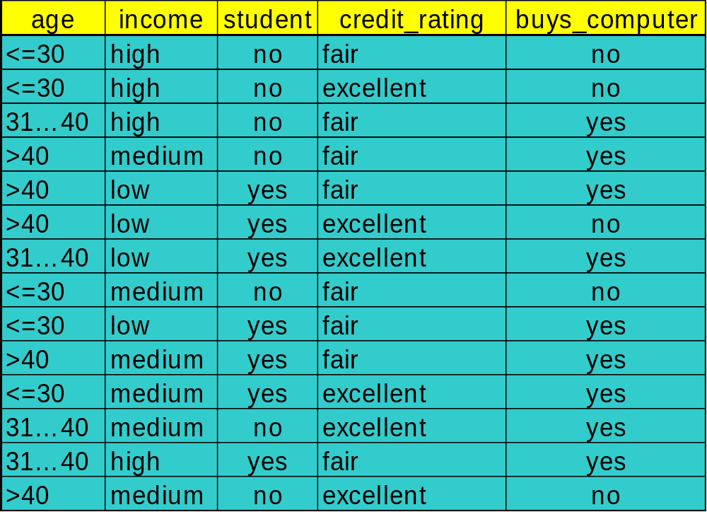
To construct Classifier from a given training data

Slide 57
Constructing Classifier
Data Domain Analysis
  Small Dataset with 04 discrete valued attributes.
  The Class label attributes are Boolean in nature!
    Class Labels:
      C1:buys_computer = ‘yes’
      C2:buys_computer = ‘no’
Predictive mechanism needed !
Business application with transactional database: no missing values !
Implementation details
  Execution of Java program with dataset.
  Constructing IF…. THEN… ELSE Rules.

Slide 58
DT induction: Issues
There are 04 attributes in the table, which attribute to start with at Root ?
  Attribute Selection measure or measure of goodness of split
    Select the attribute with the highest information gain
    Calculate information gain of each of 04 attributes by calculating;
      Expected information (entropy)
      Information needed
      Information Gained= (a)-(b)
    Find out the maximum I.G. out of attributes age, income, student, credit_rating

Slide 59




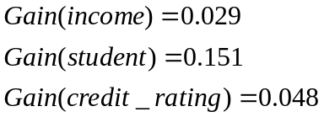
Attribute Selection: Information Gain
Class P: buys_computer = “yes”
Class N: buys_computer = “no”
means “age <=30” has 5 out of 14 samples, with 2 yes’es and 3 no’s. Hence
Similarly, Looking at other Gains, we can see the Gain(age) is max.
Data Mining: Concepts and Techniques

Slide 60

Gain Ratio for Attribute Selection (C4.5)
Information gain measure is biased towards attributes with a large number of values
C4.5 (a successor of ID3) uses gain ratio to overcome the problem (normalization to information gain)
  GainRatio(A) = Gain(A)/SplitInfo(A)
Ex.
  gain_ratio(income) = 0.029/0.926 = 0.031
The attribute with the maximum gain ratio is selected as the splitting attribute

Slide 61
Output: A Decision Tree for
“Buys_Computer”
age?
<=30
overcast
>40
31..40
Income | Student | Credit_rating | Class
High | No | Fair | no
High | No | excellent | no
medium | No | Fair | no
Income | Student | Credit_rating | Class
medium | No | Fair | yes
Income | Student | Credit_rating | Class
High | No | Fair | yes
Data Mining: Concepts and Techniques

Slide 62
Output: A Decision Tree for “buys_computer”
age?
<=30
overcast
>40
31..40
student?
yes
credit rating?
no
yes
excellent
fair
no
yes
no
yes
Data Mining: Concepts and Techniques

Slide 63
Constructing Classifier for B.I.
The leading Credit Card Company Visa International and Computer Company Acer Inc. has agreed to market the newly launched Laptop Computer.
For targeted marketing campaign, both the companies would like to use the existing database of Visa Credit card holders, to find out most likely buyers of their Computer.
For a given Database, your job will be to construct a Classifier.
This Classifier should take an input as the customer-details like
  Age,
  Income
  Student or Professional
  Credit_Card Ratings
And based on above inputs, the Classifier would Predict, whether the person is likely buyer of the Laptop Computer or not.
DTC was proposed as one of the alternative, but it showed some limitations.

Slide 64
Credit Card Database & BI application
As the Visa International has accumulated huge record of its Credit card holders for last 05 years amounting to terabytes of data.
Though larger the data better the training of the Classifiers ( some popularly used DTC algorithms C4.5 uses as much as 2/3 of the data for training the Classifiers).
In Case of our BI application, the problem starts with calculating Information Gain
    Every attributes involves all transactions for IG
    disk resident training data is not fitting into our memory for training activity.
    Scalability Problem!

Slide 65
Data Mining Software
Many providers of data mining software
  SAS Enterprise Miner, SPSS Clementine, Statistica Data Miner, MS SQL Server, Polyanalyst, KnowledgeSTUDIO, …
  See http://www.kdnuggets.com/software/suites.html for a list
  Good algorithms important, but also need good facilities for handling data and meta-data
We’ll use:
  WEKA (Waikato Environment for Knowledge Analysis)
    Free (GPLed) Java package with GUI
    Online at www.cs.waikato.ac.nz/ml/weka
    Witten and Frank, 2000. Data Mining: Practical Machine Learning Tools and Techniques with Java Implementations.
  R packages
    E.g. rpart, class, tree, nnet, cclust, deal, GeneSOM, knnTree, mlbench, randomForest, subselect

Slide 66
References
( Data Mining Concepts) J. Han, M.Kamber, Morgan Kaufmann Publications
(Association Rules) R. Agrawal, T. Imielinski, and A. Swami. Mining association rules between sets of items in large databases. SIGMOD'93.
(Max-pattern) R. J. Bayardo. Efficiently mining long patterns from databases. SIGMOD'98.
(Closed-pattern) N. Pasquier, Y. Bastide, R. Taouil, and L. Lakhal. Discovering frequent closed itemsets for association rules. ICDT'99.
(Sequential pattern) R. Agrawal and R. Srikant. Mining sequential patterns. ICDE'95
( FP Growth ) J. Han , J. Pei 2000.
DBMiner tutorials.

